Slide 1
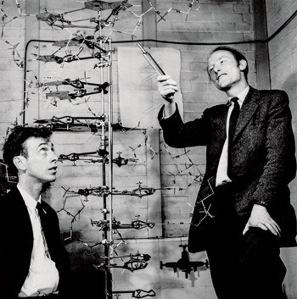
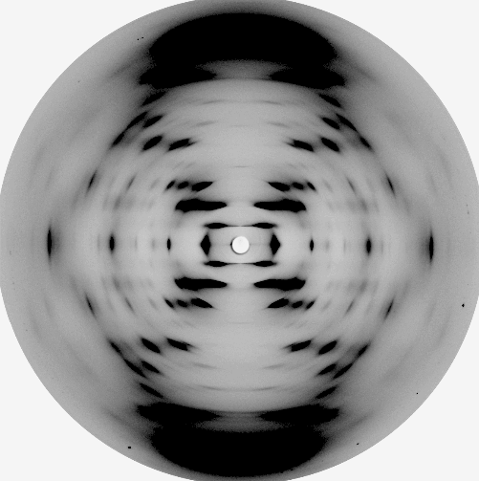
Nucleic Acids & DNA Replication
Chapter 12, Section 1

Slide 2
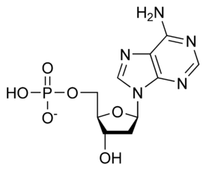
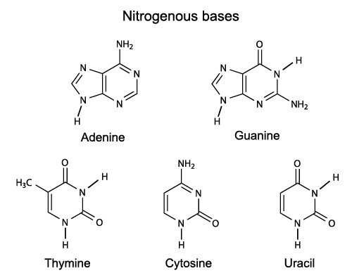
Structure of Nucleic Acids

Slide 3
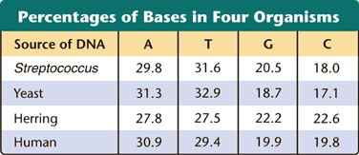
Chargaff’s Base-Pairing Rule (DNA)
Provide evidence and an explanation for the following statement:
Adenine and thymine always pair together in a strand of DNA.

Slide 4
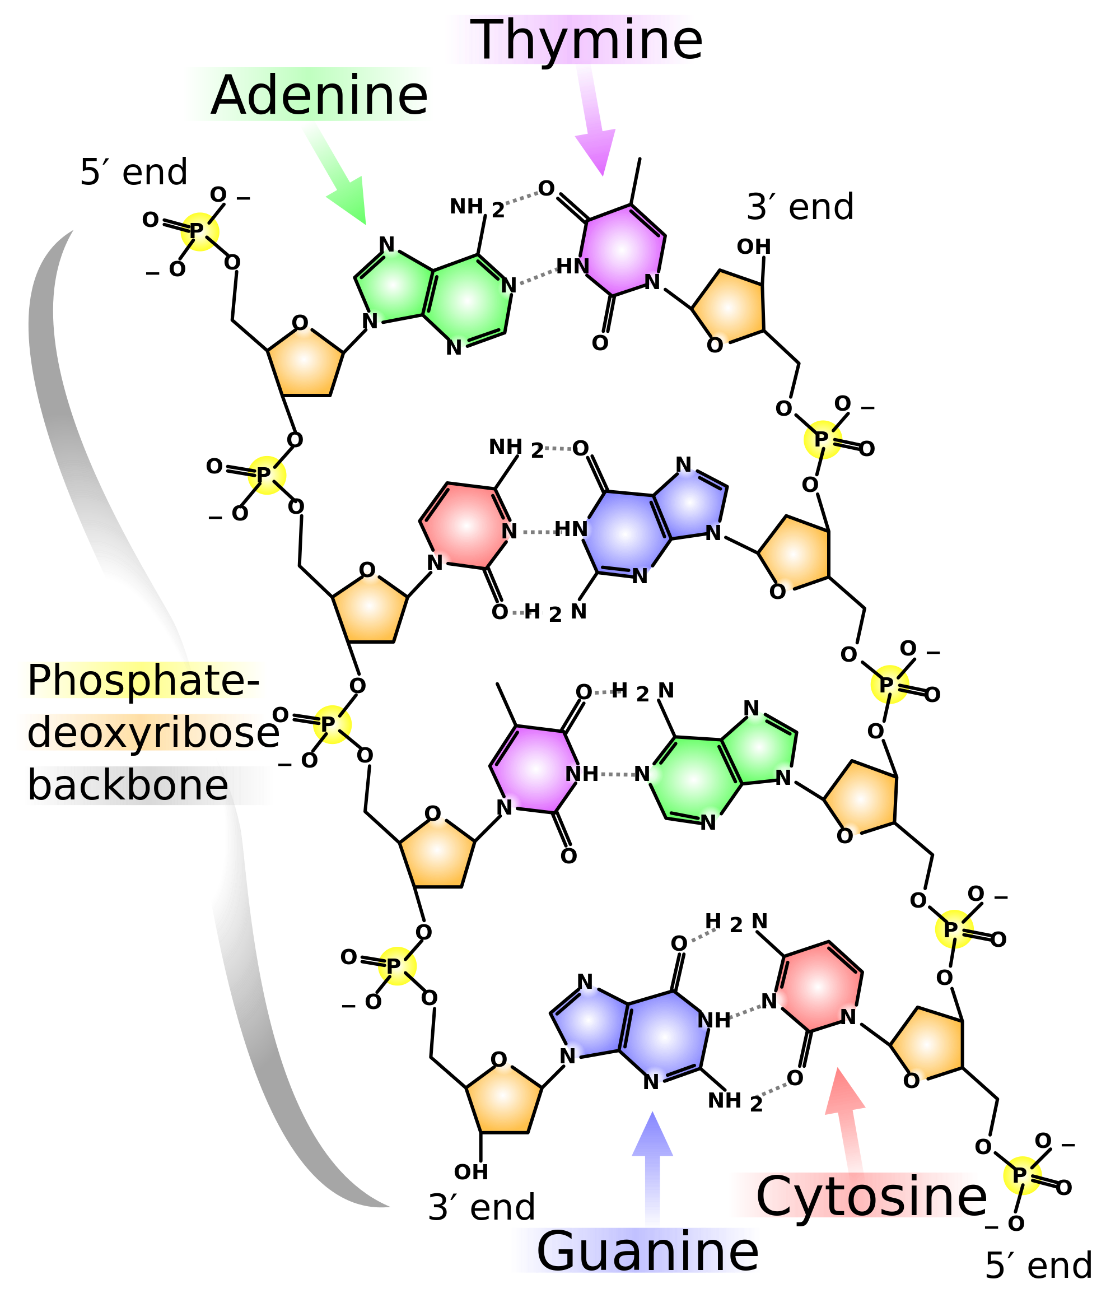

Slide 5
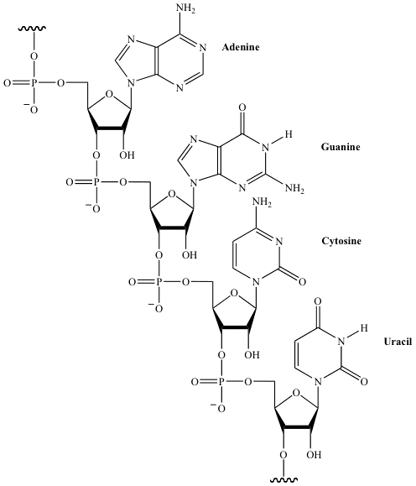
RNA

Slide 6
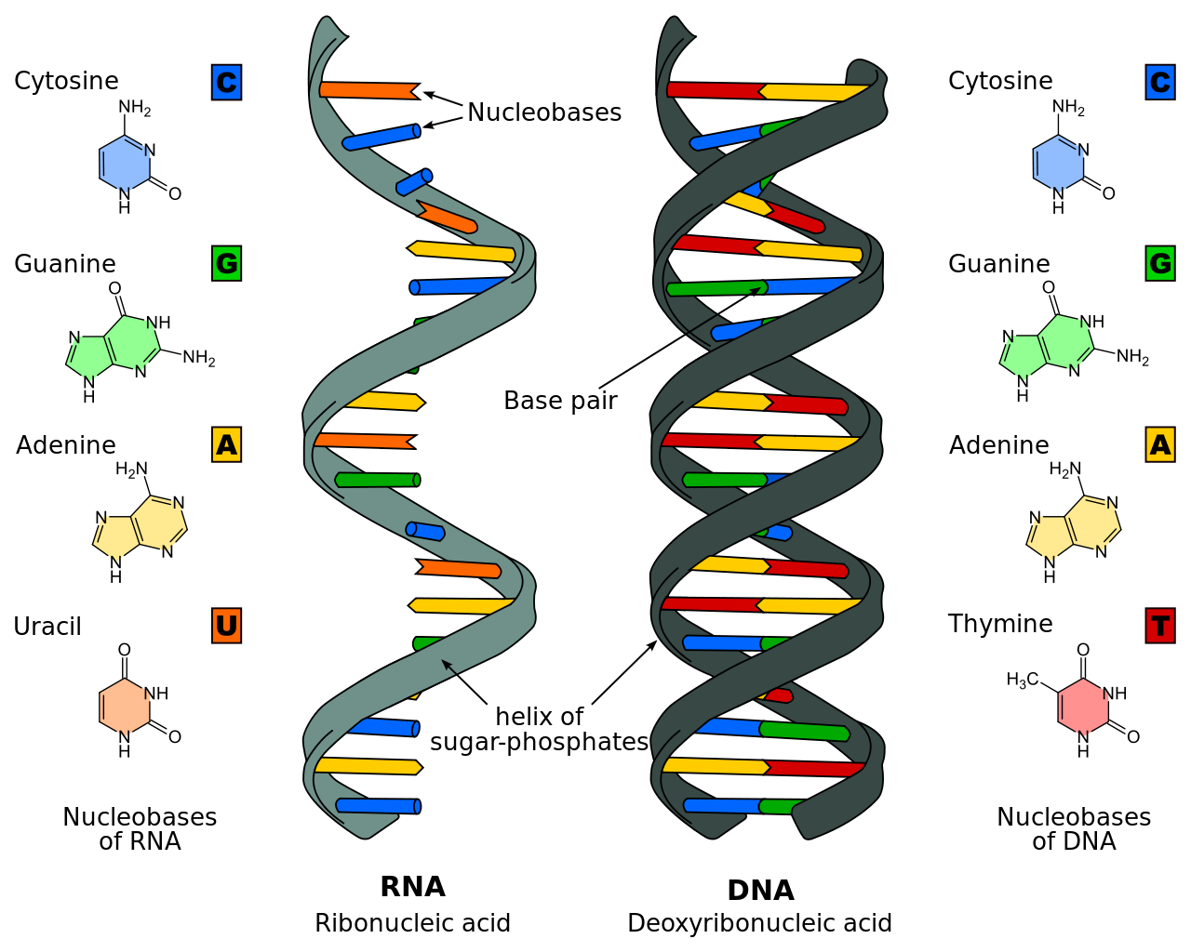
RNA vs. DNA

Slide 7
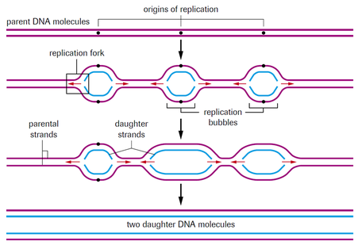
Replication is Semiconservative

Slide 8
Leading vs. Lagging Strand

